Slide 1
YOUR PROJECT NAME
PROJECT PRESENTATION
For DeFINE MENTORING PROGRAMME
www.define-network.eu

Slide 2
PROJECT NAME +Name of project holder(s)
+COUNTRY
NEED Who is your target customer and which problem he/she is facing in real life? max 70 words | APPROACH What is your solution / How will it help your customer and how it will change the way of consumption? max 50 words
BENEFITS Why is your solution more relevant & unique? Describe your innovative ideas & technology max 70 words | COMPETITION Who are your competitors/other existing solutions? max. 70 words (you can copy here the web links to these solutions)

Slide 3
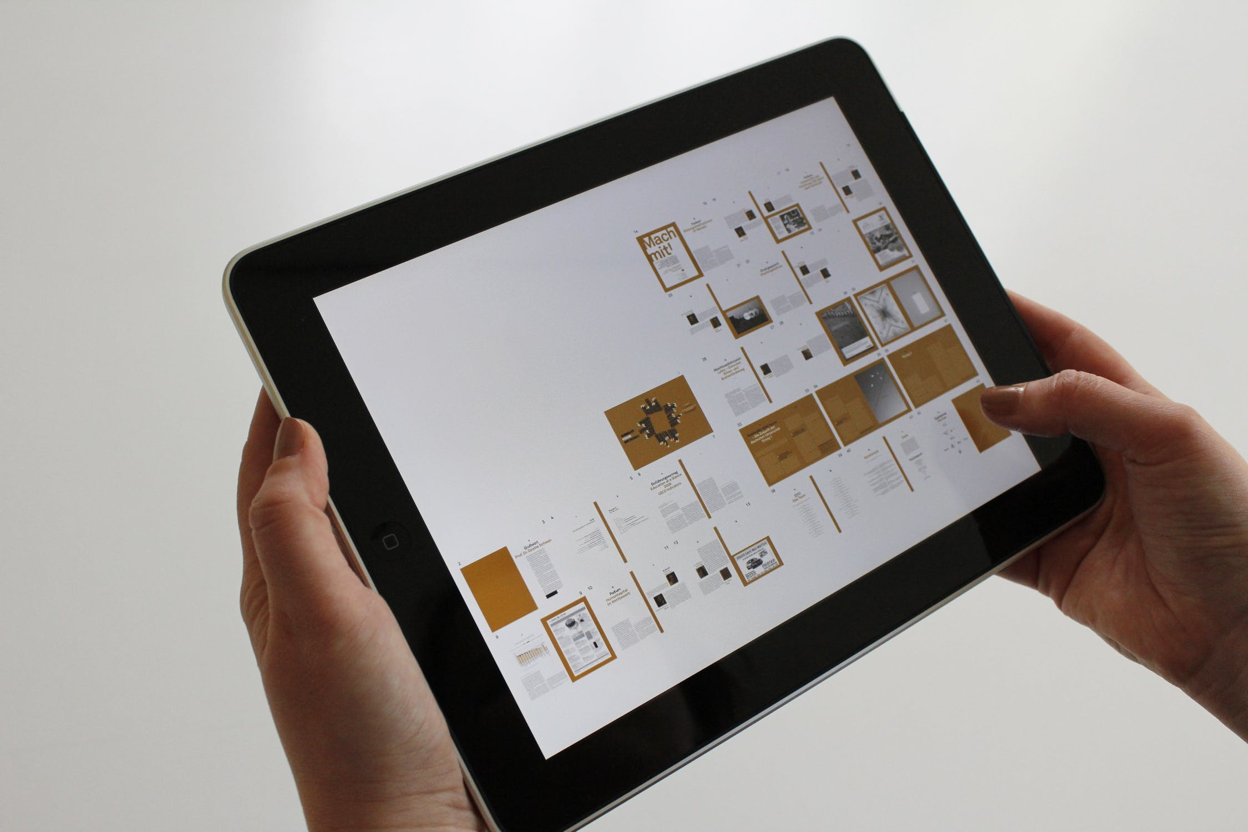
VISUAL ILLUSTRATION
Please insert any relevant visual(s) to understand your fashion tech project: 3D simulation, pictures of your product/material, graphics showing how your service works, etc... This slide could be replicated (max 3 slides).
INSERT HERE

Slide 4
THE TEAM & STAGE OF THE PROJECT
INSERT PICTURE(S) OF THE TEAM
THE FOUNDER(S) Who is (are) the founder(s) and why are they the most relevant to develop this project? max. 70 words How much time will you dedicate to the project on the coming year? In % of your full time
THE STAGE Please choose one option: R&D phase; Early prototype; Proof of concept; Commercial products; Commercially viable and highly successful; Please copy the weblink to your solution if any:
Have you already attracted investments? Yes / No If yes, from which source? Select one or more options Public Funding Through an Accelerator Crowdfunding Seed Funding If other, please specify:……………

Slide 5
YOUR CHALLENGE / OUR SUPPORT
YOUR CHALLENGE Which actions have you completed so far? max. 50 words Do you already have a clear vision of your business model (global commercial & logistical functioning)? max. 20 words Do you have a business plan (financial projections)? Yes or Not yet What are you missing/what support do you need? Select one or more options. Business Development Legal advisory Product Development Prototyping Support in Intellectual Property protection Branding/Endorsement Support in Investment Readiness Resources, equipment and facilities (see question 32 canceled) Others:……………
OUR SUPPORT What are your motivations to join the DeFINE Mentoring Programme? max. 50 words How do you concretely expect from this Mentoring phase we can provide? max. 50 words

